Slide 1
LSI Design Contest 2018 Neural Network (Backpropagation)
Huy-Hung Ho, Van-Thuat Nguyen,
Xuan-Thuan Nguyen, Van-Dung Nguyen
Key Laboratory for Smart Integrated Systems (SISLAB)

Slide 2
Outline
LSI contest
Hardware implementation

Slide 3
LSI Contest
8th Oct. 2017
Backpropagation algorithm
Reading software optimization
Convert verilog code to vhdl
6 weeks
18th Nov. 2017
Optimized sub-part
Insert momentum
2 state: offline, online
8 weeks
Synthesis vhdl, evaluation speed, area (use Vivado)
18th Jan. 2018
v
Writing document, report and send to LSI contest
2 weeks
31st Jan. 2018

Slide 4
Outline
LSI contest
Hardware implementation

Slide 5
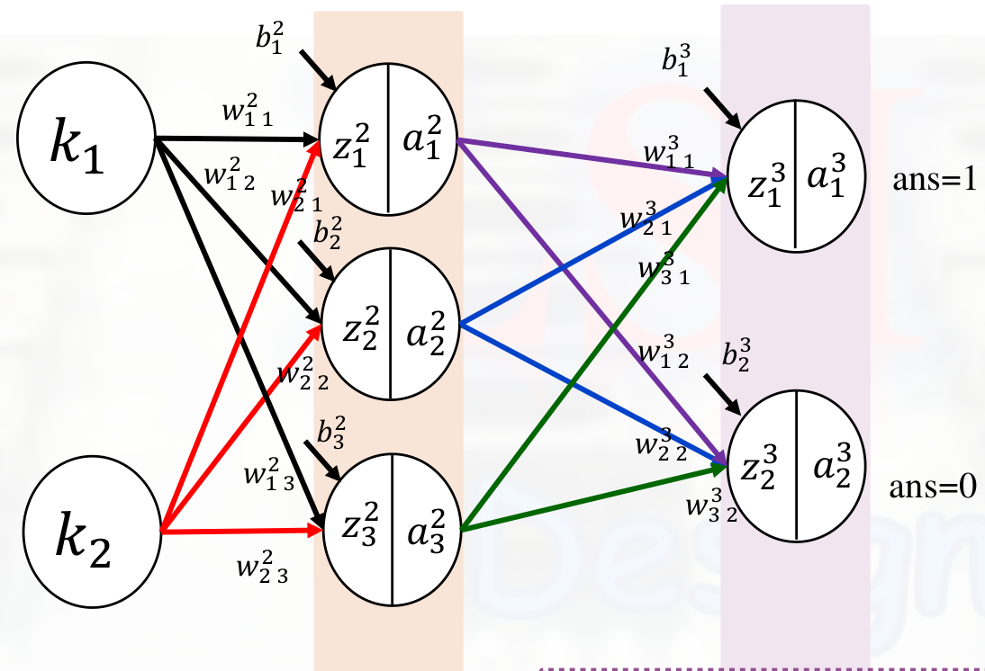
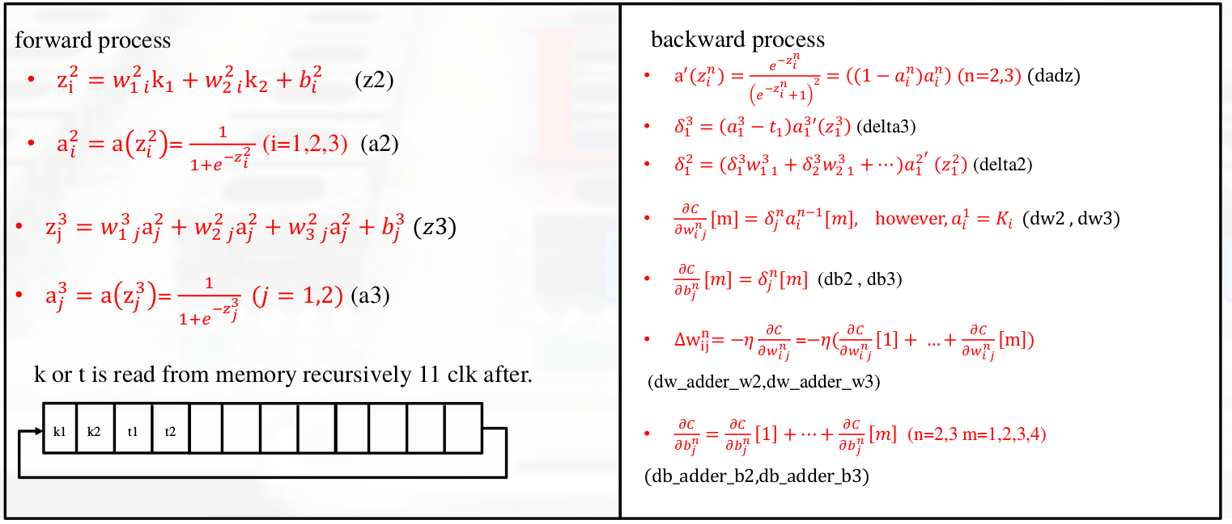
Hardware example

Slide 6
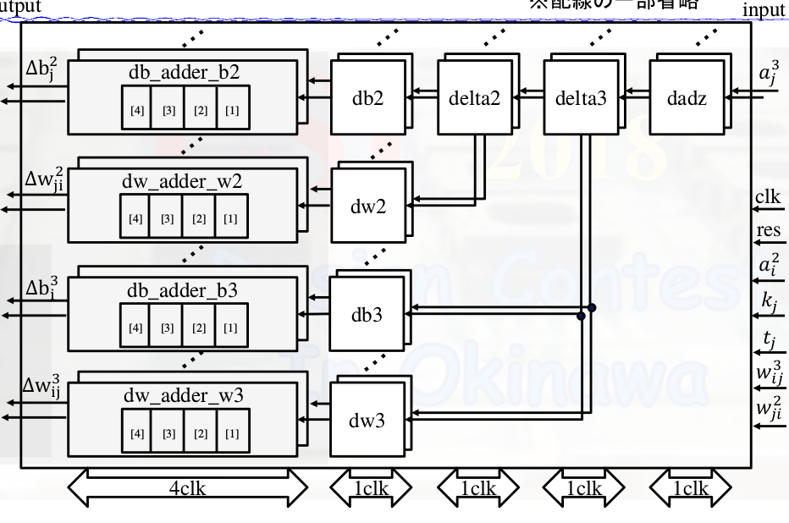
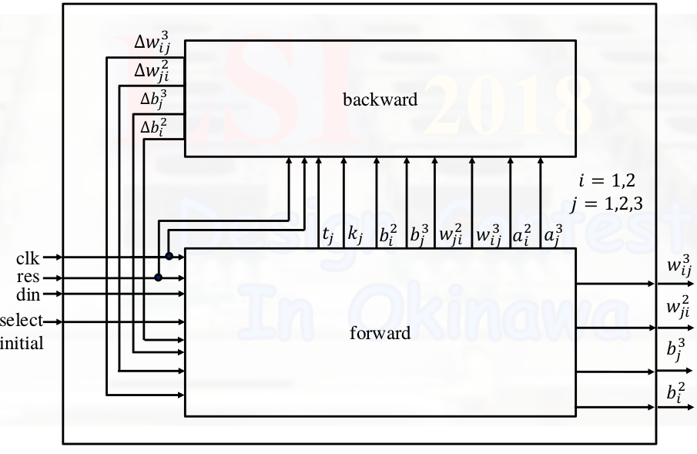
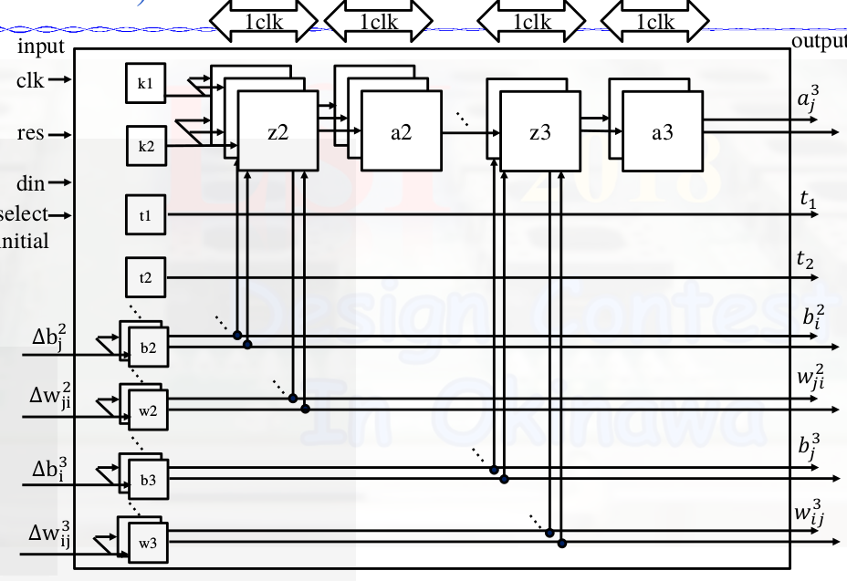
Hardware example
12 cycle / time

Slide 7
The end

Slide 8
Backup
Introduction LSI Contest
Artificial neural network
Backpropagation algorithm
Conclusion

Slide 9
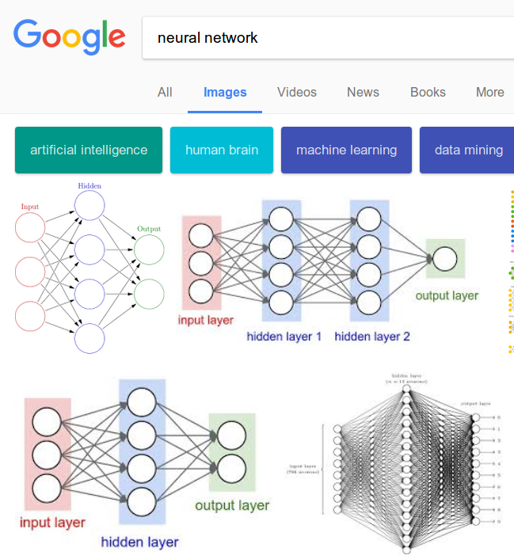
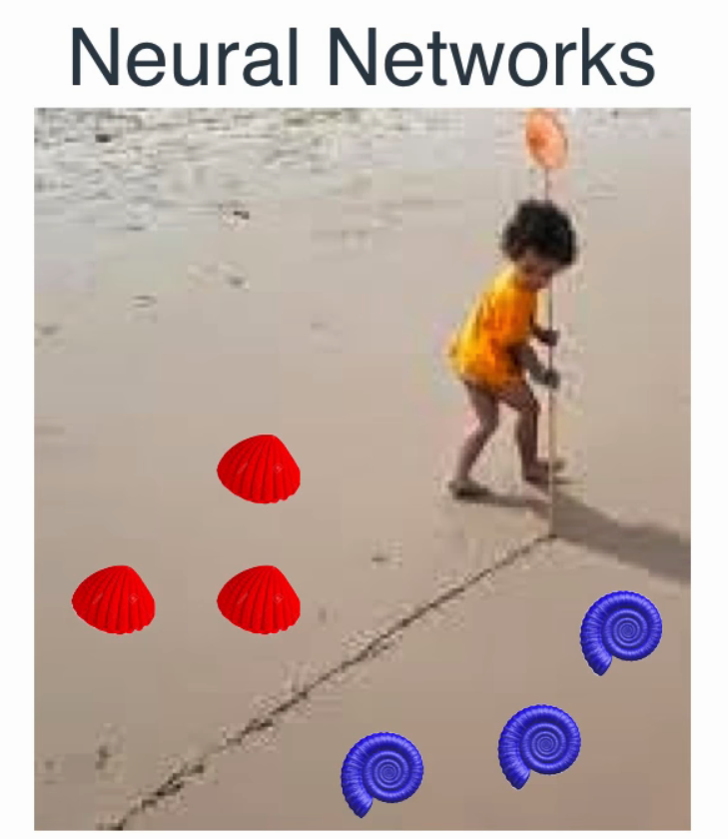
Artificial neural network

Slide 10
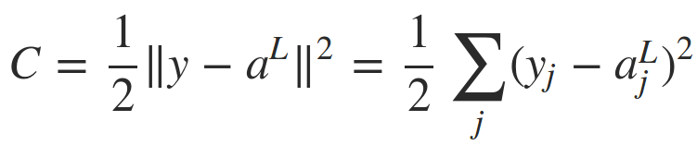


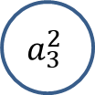
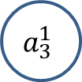



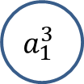

The matrix
Input layer (1)
Hidden layer (2)
Ouput layer (3)
$$b_{1}^{3}$$
$$a_{3}^{1}$$
$$w_{ 1}^{3}$$
$$a_{1}^{3}$$
$$a_{1}^{L}$$
$$a_{3}^{2}$$
$$Cost =C(a^{L})$$
$$a_{2}^{L}$$
Activation output:
Square error:

Slide 11

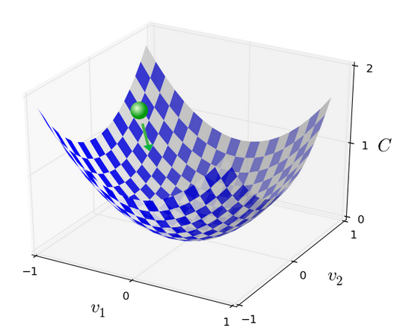
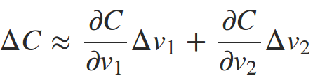
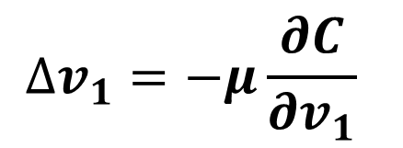
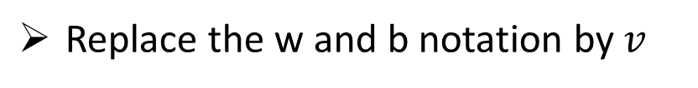
Gradient Decent
Cost Function (mean squared error – MSE)
Replace the w and b notation by $v$
$$∆v_{1}=−μ\frac{∂C}{∂v_{1}}$$
Gradient Decent

Slide 12


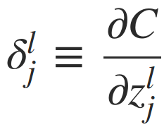




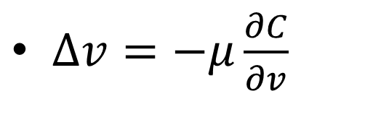
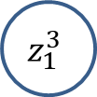



Backpropagation algorithm
$∆v=−μ\frac{∂C}{∂v}$
How quickly the cost change when we change the weights and biases
Weighted input:
$$b_{1}^{3}$$
$$w_{ 1}^{3}$$
$$z_{1}^{3}$$
$$a_{1}^{3}$$
$$a_{2}^{2}$$
Error of neuron:
$$δ_{}^{1}$$
$$δ_{}^{2}$$
$$δ^{L}$$

Slide 13


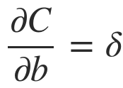
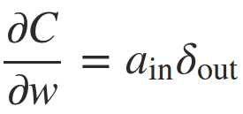



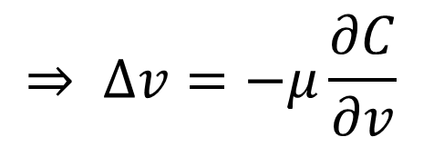


Backpropagation algorithm
$$δ_{}^{l}$$
$$z^{l}$$
$$δ^{L}$$
$$z^{L}$$
$$a_{}^{L}$$
$$⇒ ∆v=−μ\frac{∂C}{∂v}$$

